Slide 1
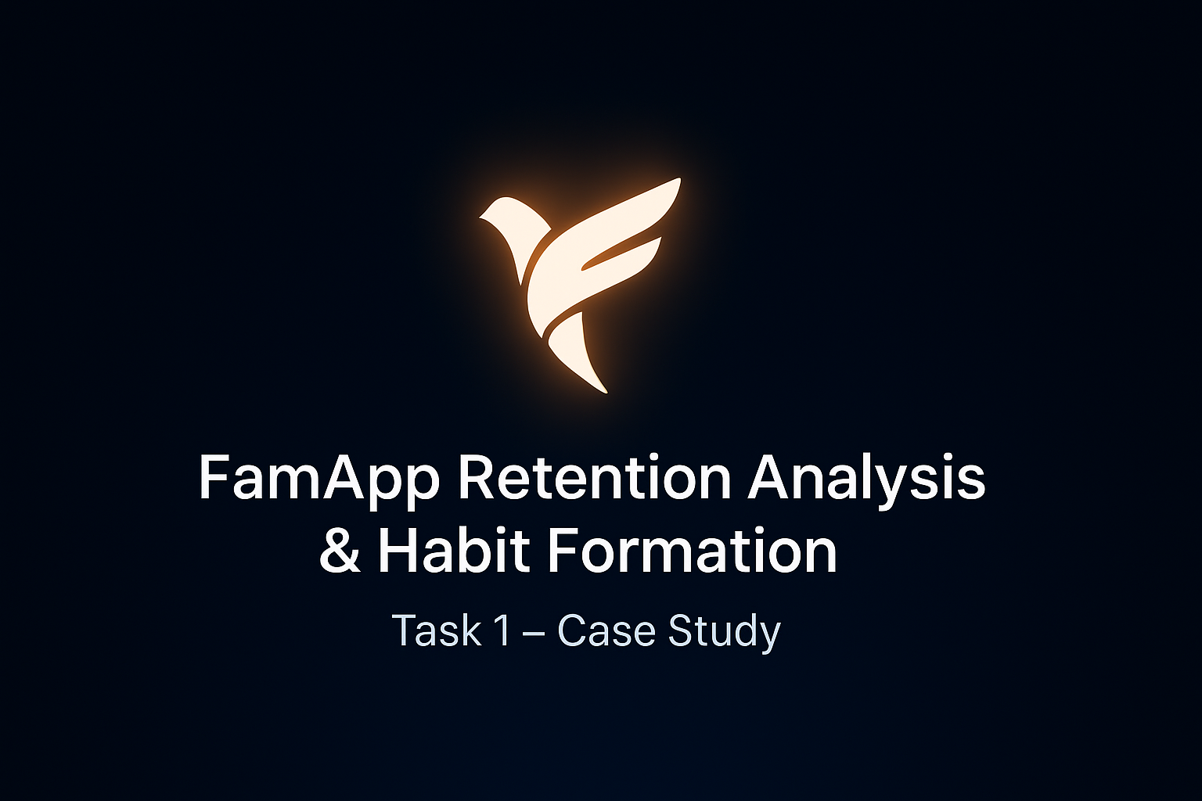

Slide 2
Why Retention & Habit Formation Matter
Retention drives growth
Acquiring new users is 5–7x costlier than retaining existing ones.
Retained users transact more frequently → higher LTV (Lifetime Value).
Habit formation = stickiness
Frequent usage builds familiarity & trust.
Reduces churn and increases customer loyalty.
Impact on FamApp
Higher retention → stable revenue base
Habitual users adopt multiple services (P2P, card, recharge, etc.).
Strong network effects: retained users bring friends/family.

Slide 3
How We Analyze Retention
Definition of Retained Users = Active ≥ 3 months with completed transactions.
Compared Retained vs Non-Retained across key behavioral & demographic metrics.
Metrics Analyzed:
1. Avg. transactions per month
2. Time from activation → first transaction
3. Transaction type distribution (Merchant / P2P / Card)
4. Avg. transaction value
5. Age group distribution
6. How Long Do Users Stay Active?
7. % of Users with Multiple Transaction Types

Slide 4
1.Avg. Transactions per Month
CALCULATION: Total_txns / active months per user (Grouped by retained/ not retained )
INSIGHT:Higher transaction frequency (users who transact 2–3x more monthly are more likely to stick).
NUDGE:Push for repeat transactions (e.g., cashback after X transactions in a month)

Slide 5
2. Time Between Activation & First Transaction:
CALCULATION: First_txn_date – Activation_date
INSIGHT: Retained users transact quickly after activation
NUDGE:Encourage an immediate first action (welcome bonus / instant “first spend” offer).

Slide 6
3.Transaction type distribution( Merchant vs P2P vs Card)
CALCULATION: Count transactions by type for each retention group
INSIGHT: Both RETAINED & NOT RETAINED ones diversify usage, especially not retained ones transact via personal,merchant & card heavily.
NUDGE: Offer rewards for trying new transaction types for both retained and not retained to form habit & retain not retained ones respectively(e.g. “Rs 20 cashback on 1st card payment”

Slide 7
4.Avg. Transaction Value
CALCULATION:Mean transaction amount by retention group.
INSIGHT: Retained users have higher avg, min transact value hence showing stronger intent & retention.
NUDGE:Incentivize mid-ticket spends (e.g., ₹200+ merchant cashback)

Slide 8
5. Age Group Distribution
CALCULATION: Age group vs Retention
INSIGHT: Retention differs by age group, Young adults & Adults are likely to retain more than other age groups
NUDGE: ADULTS & YOUNG ADULTS Financial tools like budget tips,savings nudges
TEENS Gamify with badges & streaks

Slide 9
6. HOW LONG DO USERS STAY ACTIVE/ FREQUENCY CONSISTENCY
CALCULATION: Number of active months per user
INSIGHT:Consistency across 3+ months is the real habit — users who cross this threshold rarely churn.
NUDGE :Loyalty rewards unlocked progressively (Month 1, 2, 3 milestones).

Slide 10
7.SINGLE vs MULTI TYPE TRANSACTION USERS
CALCULATION: Users with >= 2 txn types vs only 1 type, by retention
INSIGHT: Multi type users are more retained
NUDGE:Cross – Cross-sell multiple use cases early (UPI + Card combo offers).

Slide 11
KEY HABIT FORMING PATTERNS:
Frequent transactions → Retained users transact 2–3x more per month
Quick activation → Faster first txn → higher retention
Diverse use cases → Merchant + P2P + Card users retain better
Higher avg. spend → Bigger txn values signal stronger commitment
Consistency → Staying active ≥3 months builds lasting habit
Multi-type usage → Users with ≥2 txn types churn less

Slide 12
Recommendations & Nudges
Accelerate first transaction: Onboarding rewards, instant cashback for first spend.
Drive higher frequency: Monthly streak challenges, milestone rewards for repeat txns.
Promote diverse use cases:Cross-sell merchant + P2P + card with bundled offers.
Encourage mid-ticket spends:Cashback / discounts for ₹200+ transactions.
Build consistency across months:Loyalty program unlocking perks after 1st, 2nd, 3rd month
Reinforce multi-type usage: Incentives for trying ≥2 txn types early (e.g., UPI + card combo).

Slide 13
APPENDIX
Full SQL code & CSV outputs attached separately in submission
BY ,APPLICANT PRODUCT ANALYST INTERN -SAI GAUTHAM GODALA

